Slide 1

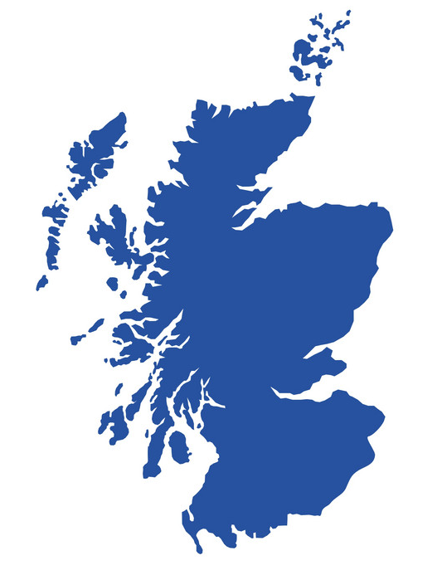
Review of Scotland's Domestic Tourism 2013 to 2019
Barry O’Dea
22/09/2021

Slide 2
Project Overview
VisitScotland is the national tourism organisation for Scotland. Their main aim is to contribute significantly to the advancement of Scottish tourism by giving it a real presence in the global marketplace and benefiting the whole of Scotland.
Brief
Provide insights into Scottish Domestic Tourism for Day Visits and Regional Tourism based on 2013 to 2019 Scot Gov data.
Day Visits based on:
- Activities
- Demographics
- Location Type
- Transportation
Regional Tourism based on:
- Areas visited
- Tourist’s residency
Approach: Exploration of the past data to see how each category influenced the spend and visits and then investigate what common insights could be identified across the data sets.

Slide 3
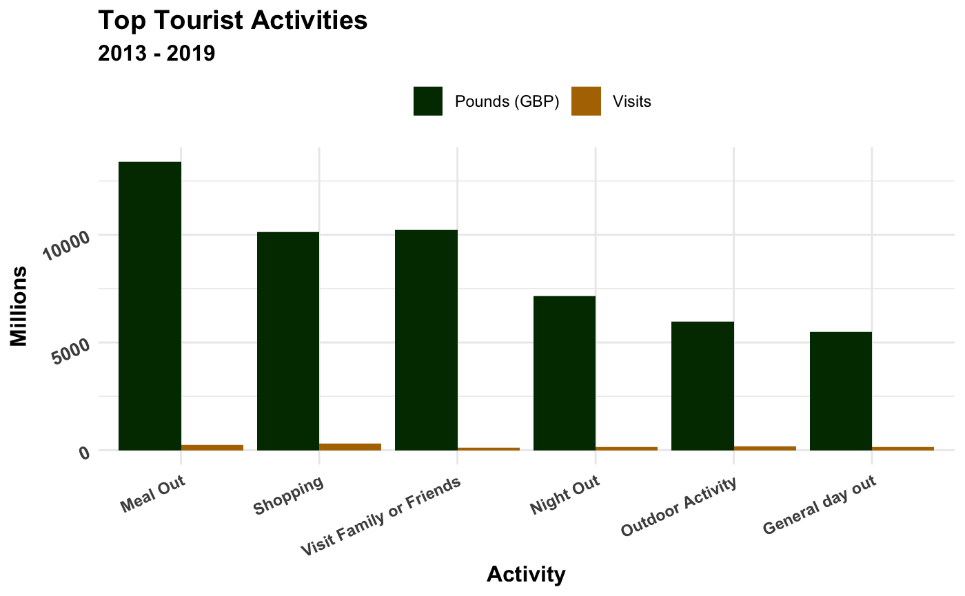
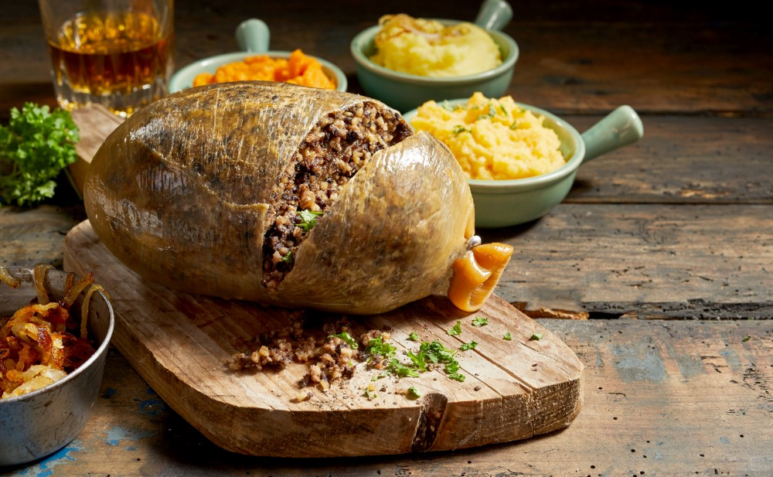

Day Visits: What activities attract most visitors and generate most revenue?
The top income generating activities from day visit are meals out, shopping , visiting friends and family and nights out. In terms of number of visits outdoor activities and general day outs feature higher but do not generate as much income.

Slide 4
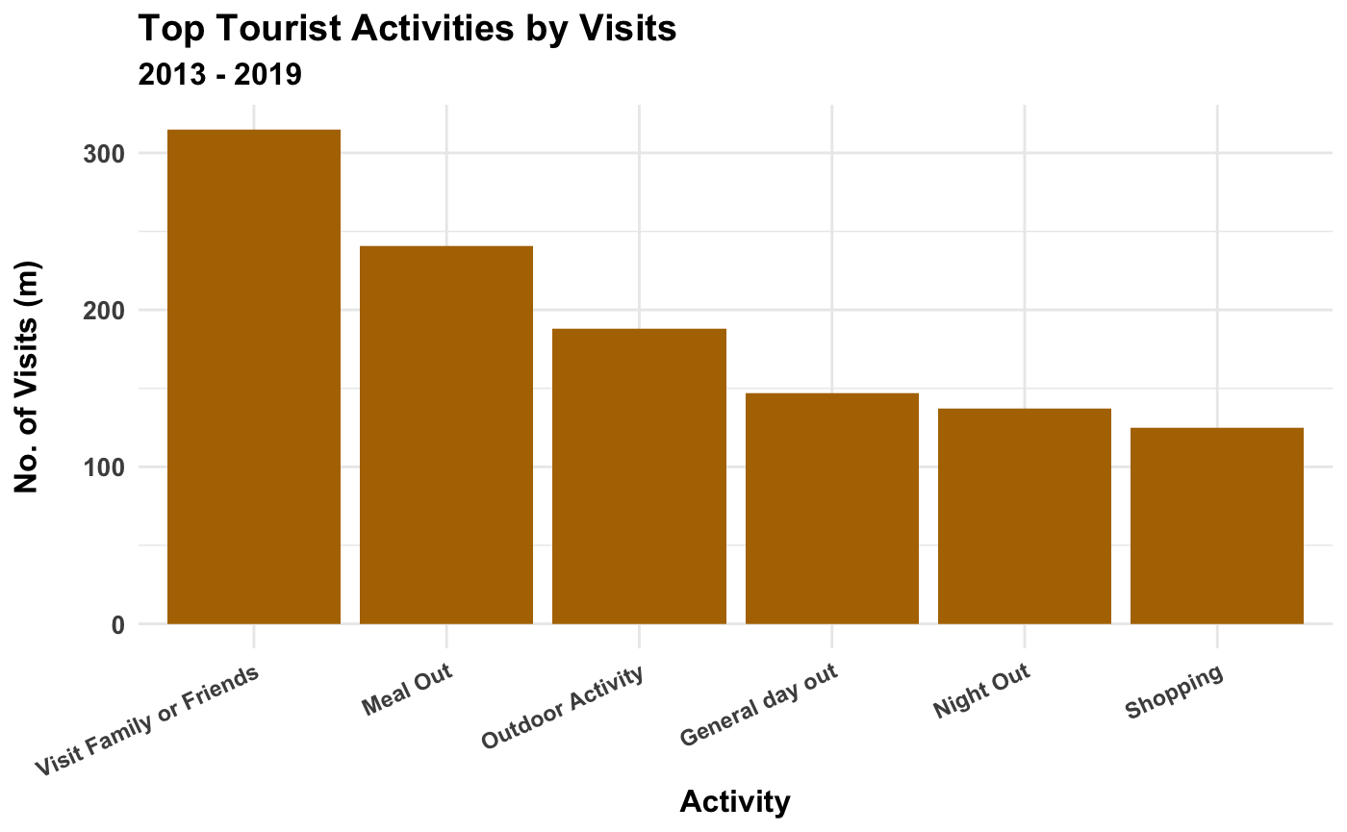
Day Visits: Top Activities by visits
Although there is a strong relationship between number of visits and income generated there are some activities that generate more income with less visits. Shopping for one off items is a good example of this.

Slide 5

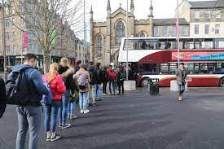
Day Visits: What demographics should Visit Scotland focus on?
Highest Spending Demographics
Demographic | Expenditure (£m)
Access to car (1+) | 30,623
Married | 23,928
No - Children | 23,443
Employed/self-employed | 23,045
Lowest Spending Demographics
Demographic | Expenditure (£m)
16-24 years | 5,217
No access to car (0) | 5,128
65 years and over | 5,070
Unemployed/not working | 4,267
In full or part time education | 2,659
The top spending demographics are people with access to one or more cars, are married, with no children or are in full or part time employment.
The lowest spending demographics are people with aged 16 – 24 and 65 and over, have no access to a car, are unemployed or in full or part time education.

Slide 6
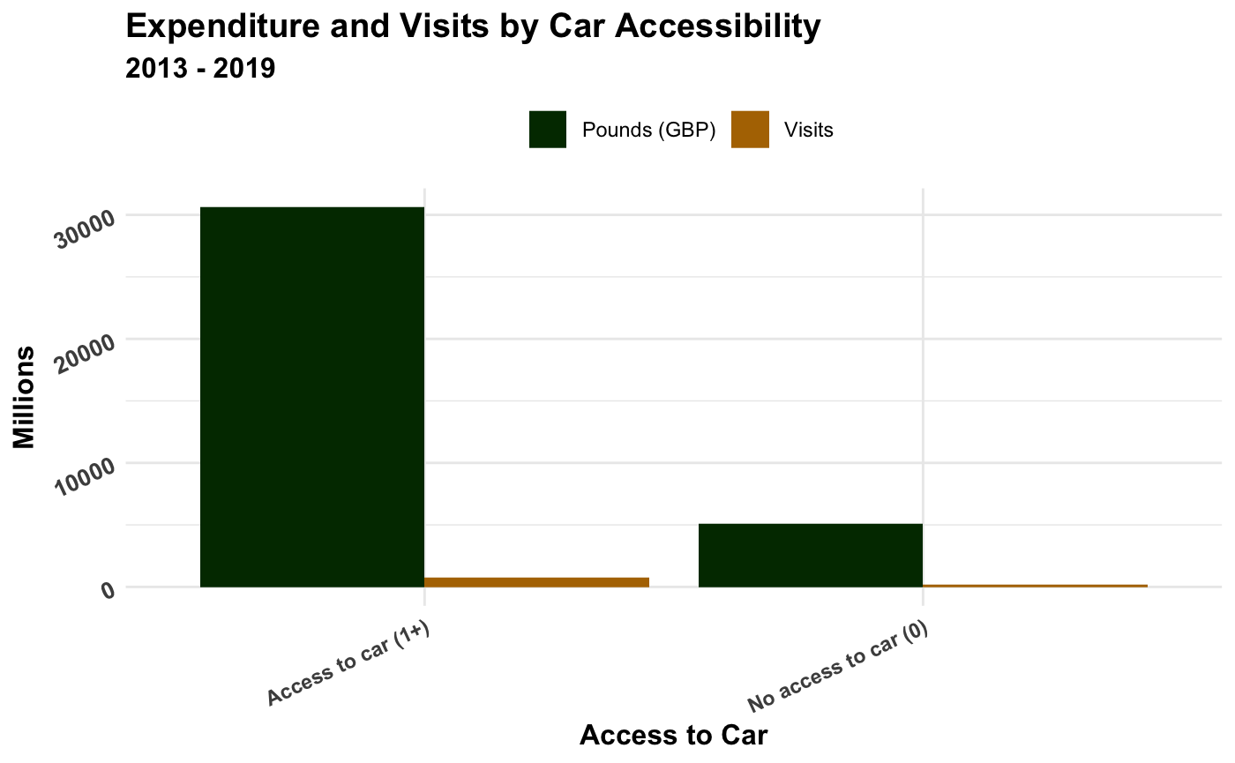
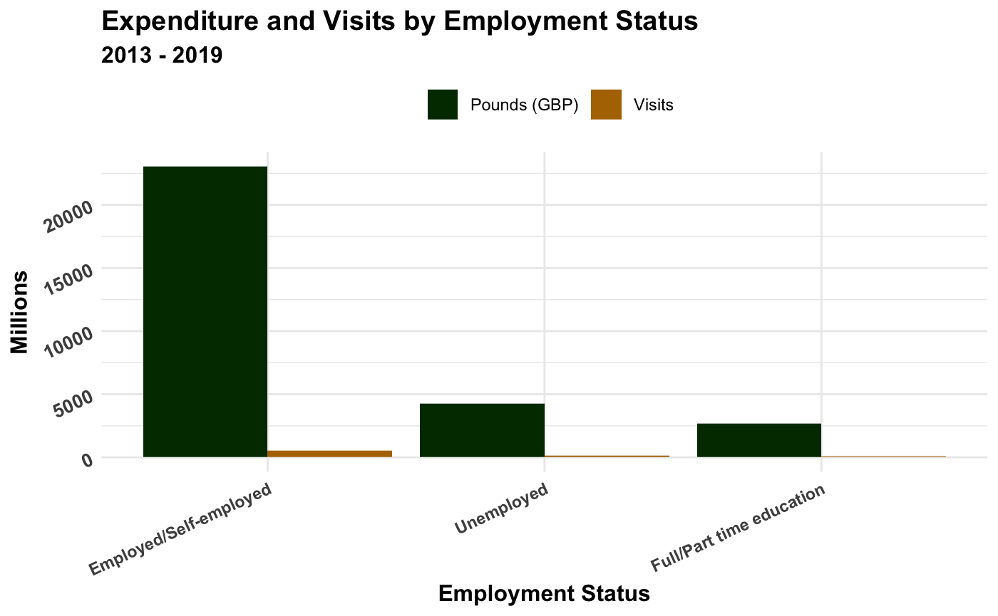
Day Visits: Difference in Expenditure and Visits for Car Accessibility and Employment Status

Slide 7
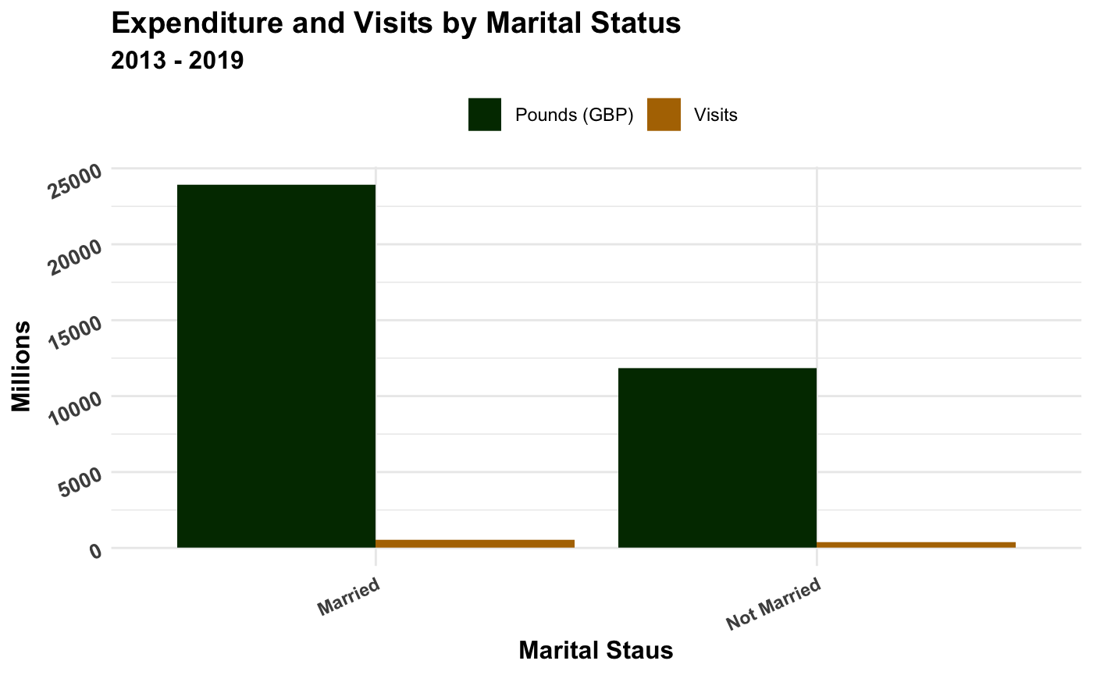
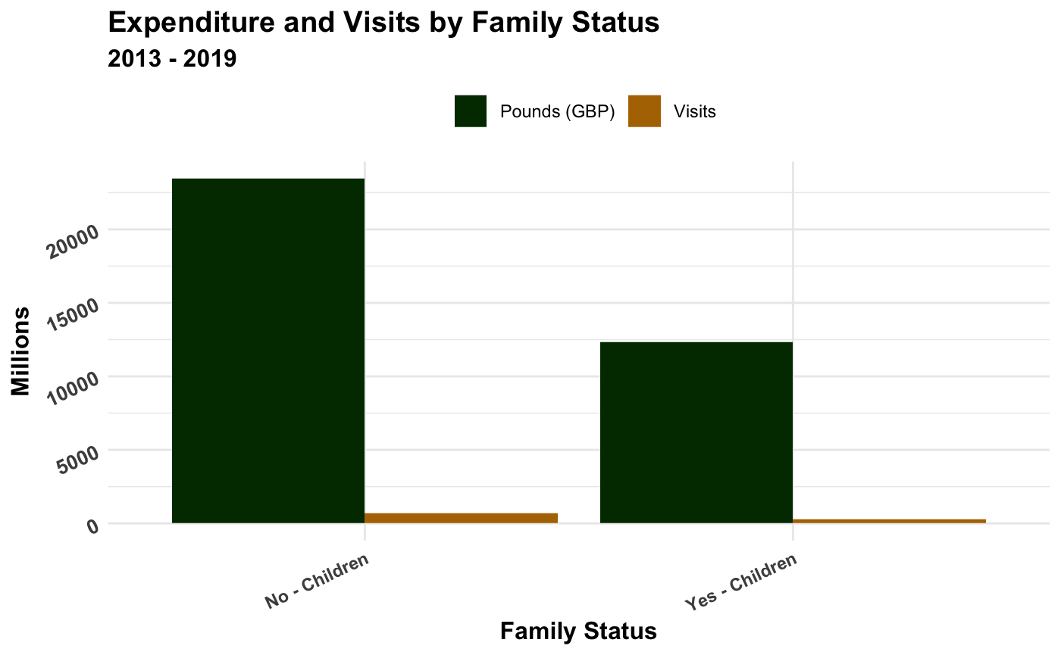
Day Visits: Difference in Expenditure and Visits for Marital and Family Status

Slide 8
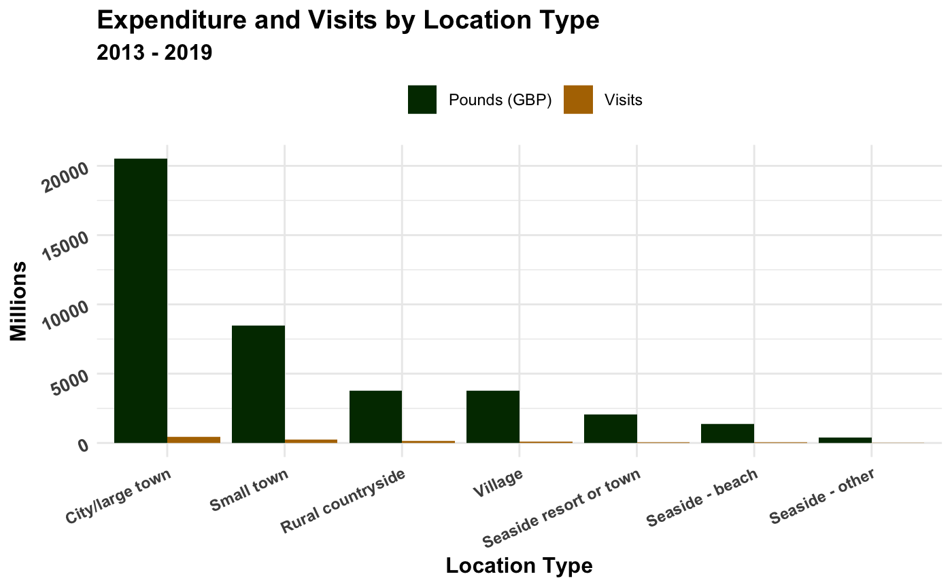
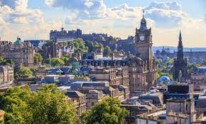
Day Visits: What type of locations receive the most visits and expenditure?
Type of Location | Expenditure (£m) | Visits (m)
All areas | 35,751 | 940
City/large town | 20,497 | 431
Small town | 8,451 | 254
Rural countryside | 3,788 | 133
Village | 3,774 | 106
Seaside resort or town | 2,069 | 57
Seaside - beach | 1,367 | 37
Seaside - other | 380 | 14
Cities and large towns make up 57% of expenditure and 46% of all day visits to Scotland

Slide 9
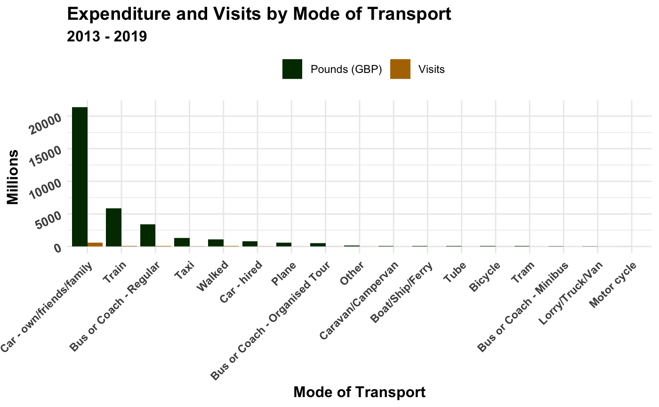
Day Visits: Is there a particular method of travel our visitors arrive by?
Mode of Transport | Expenditure (£m) | Visits (m)
All | 35,751 | 940
Car - own/friends/family | 21,345 | 587
Train | 5,886 | 105
Bus or Coach - Regular | 3,412 | 91
Taxi | 1,326 | 28
Walked | 1,132 | 58
Car - hired | 815 | 19
Plane | 604 | 7
People arriving by cars (not hired) make up 60% of expenditure and 62% of all day visits to Scotland

Slide 10
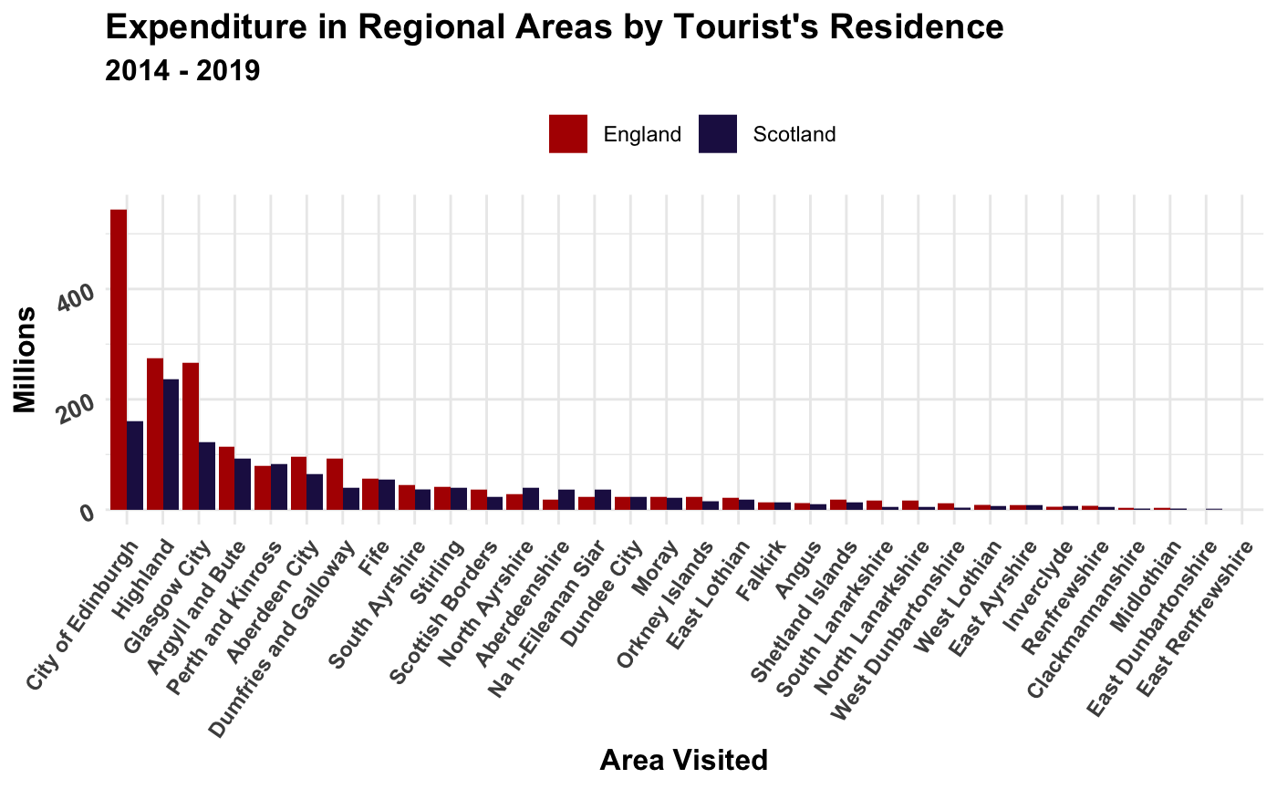
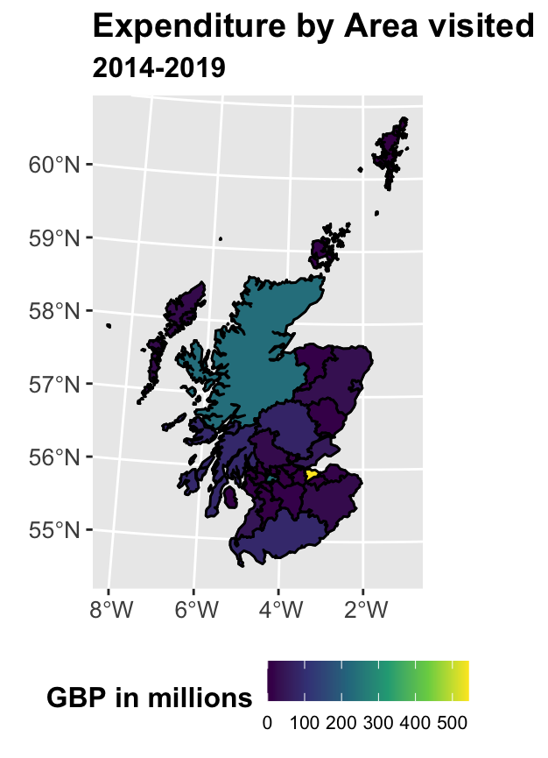
Overview of Regional Tourism in Scotland

Slide 11
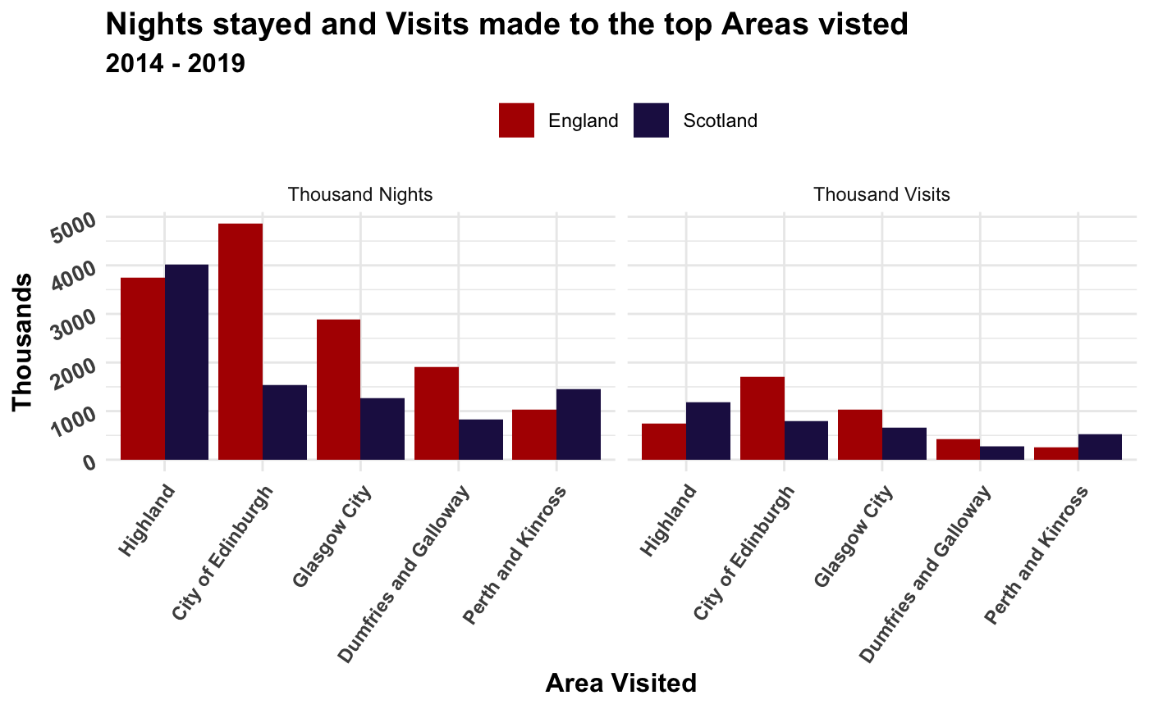

Overview of Regional Tourism in Scotland
This overviews indicates that English tourists tend to visit and stay longer in larger cities or areas near the border, while Scottish tourists visit and stay longer in the rural areas of Scotland.
The expenditure overview indicates that majority of Scotland’s domestic tourism income is generated from English tourists.

Slide 12
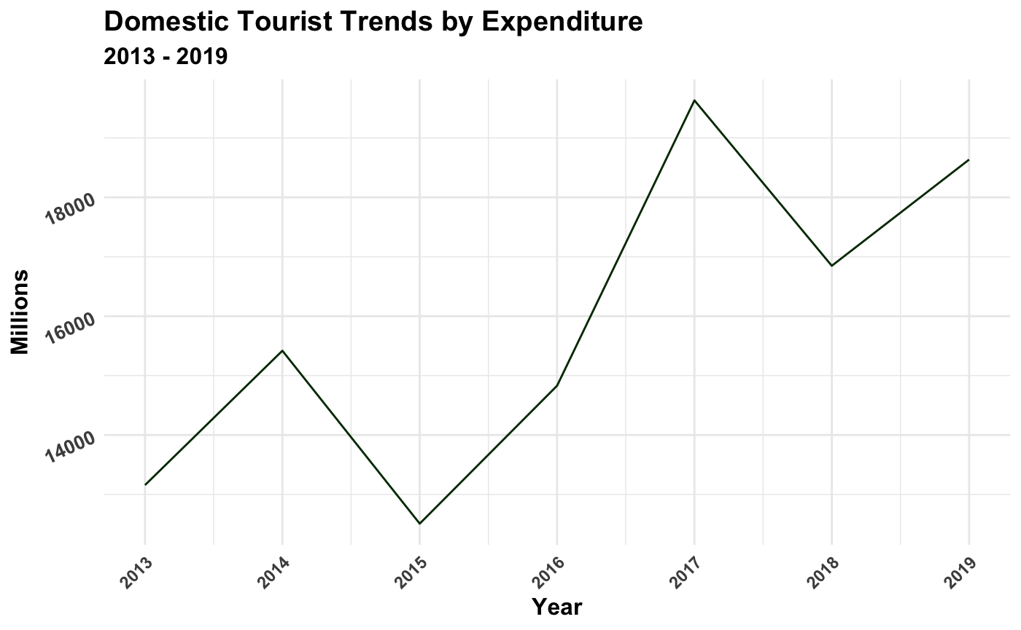

Domestic Tourism - Day Visit Trends
There is an overall upward trend in the income generated by day visits to Scotland. From some research it looks like the dip in income was due to a decrease in the number of visitors from England that year.

Slide 13
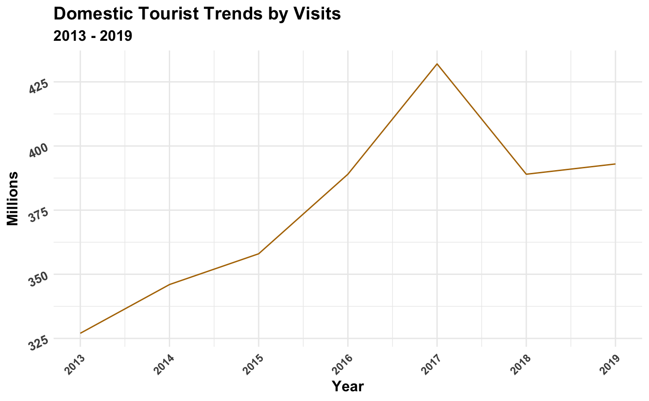
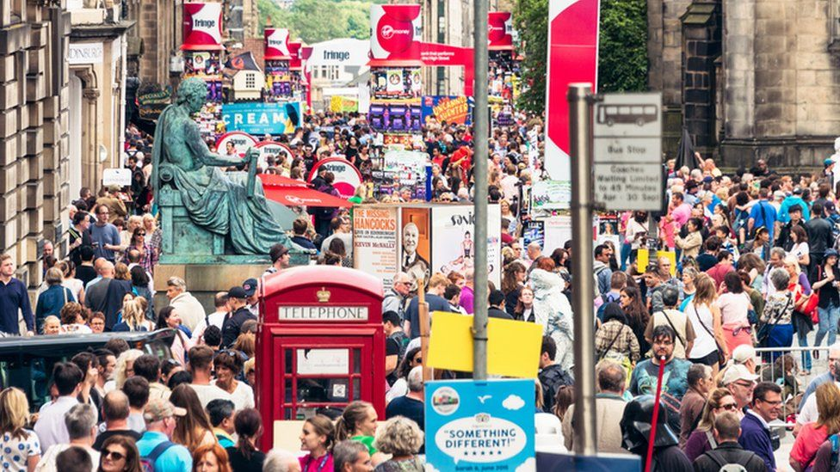
Domestic Tourism - Day Visit Trends
Similarly, there is an overall upward trend in the number of day visits to Scotland showing the more visitors Scotland attracts the higher the income they will generate.

Slide 14
Is there any way to predict spending and visits for Visit Scotland?
Linear Model to predict number of visits to Scotland:
- based on demographics data of visitors from 2013 to 2019
- taking key demographic categories based in their correlation to number of visits
Predictors in Model | Demographic Category | Percentage of outcome predicted by model
Has Access to a car – Yes | Access to car | 68.26%
Married | Marital Status | 88.62%
In full/part time education | Employment Status | 94.36%

Slide 15
Key Insights and further analysis
Areas visited and Transport:
For both day visits and regional tourism, the most popular destinations were Scottish cities.
People with access to cars are spending significantly more than those without a car on day visits and 60% of all visitors are arriving by car.
Questions: Are improvements needed to the public transport system in Scotland to encourage use?
What can be done to roads/transport system to improve accessibility to rural parts of Scotland?
Activities:
Meals and nights out are at the top of income generating activities. Therefore, it is important to get the hospitality sector back up and running as quickly as possible after covid.
Regional Tourists:
Domestic tourism relies heavily on tourists from England. Efforts need to be made to maintain and increase the level of visitors from England. This will be important as international travel is opening up again and people are looking at booking foreign holidays.
Challenges and further analysis:
Data only available up to 2019, therefore impacts of Covid on tourism haven’t been considered.
Data on day visits only available in years and for regional tourism in 3-year blocks therefore additional breakdown would be needed to investigate the regional trends and the seasonality of the tourism.

Slide 16


